Slide 1
Chapter – 8 (N 10 to 12 marks)
Capital Structure and Leverage

Slide 2
Concept of Capital Structure
Capital structure refers to the mix of different sources of long-term financing that a company uses to fund its operations and investments. These sources typically include a combination of equity and debt. Equity represents ownership in the company, and it is raised by issuing stocks, while debt involves borrowing money through loans or bonds.
The capital structure decision is crucial for a company because it influences both its risk and cost of capital. There are two main components of capital structure:
Equity:
Common stock: Represents ownership in the company, and shareholders have voting rights.
Preferred stock: Carries certain privileges, such as a fixed dividend, but generally does not include voting rights.
Debt:
Loans: Money borrowed from financial institutions or lenders, usually with a fixed interest rate and a specified repayment period.
Bonds: Debt securities issued to investors, typically with a fixed interest rate and maturity date.
Optimal capital structure is the mix of debt and equity capital that results to minimum weighted average cost of capital.
The financial manager should attempt to maintain optimal capital structure that maximizes the value of the firm and minimizes the cost of capital.

Slide 3
Factors Affecting capital Structure Decision
Growth in sales
Business Risk
Debt service Capacity
Operating leverage
Size of a firm
Stability in cash flow
Nature of industry
Asset Structure

Slide 4
Concept of optimal capital structure
The optimal capital structure is the ideal mix of debt, equity, and other financing sources that minimizes a company's overall cost of capital (WACC) while maximizing its market value. It balances the benefits of debt, such as tax savings from interest deductibility, against the risks of financial distress or bankruptcy from excessive leverage. Achieving the optimal capital structure involves tailoring the financing mix to the company’s specific financial goals, risk tolerance, industry norms, and market conditions, ensuring long-term sustainability and growth.

Slide 5
Key Features of Optimal Capital Structure:
Minimized Cost of Capital:
It reduces the weighted average cost of capital (WACC), which is the cost of equity and debt weighted by their respective proportions in the company's capital structure.
A lower WACC enhances the company's valuation.
Maximized Firm Value:
By balancing risk and return, the optimal capital structure helps maximize shareholder wealth.
Balance Between Debt and Equity:
Debt financing is generally cheaper than equity due to tax benefits (interest is tax-deductible).
However, excessive debt increases financial risk and the possibility of financial distress or bankruptcy.
Sustainability:
The capital structure should support the company’s ability to service its debt while allowing flexibility for growth and unforeseen expenses.
Industry and Market Conditions:
Optimal capital structures vary by industry, economic conditions, and a company's stage in its lifecycle.

Slide 6
Factors Influencing Optimal Capital Structure:
Cost of Debt and Equity:
Companies must weigh the relative costs of raising funds through borrowing versus issuing equity.
Tax Implications:
Debt can offer tax advantages, as interest payments are tax-deductible, unlike dividend payments.
Risk Tolerance:
Higher leverage increases financial risk. Companies must assess their ability to handle increased debt.
Asset Structure:
Companies with more tangible assets can generally sustain higher levels of debt due to lower risk for lenders.
Market Conditions:
Economic environments and interest rate levels influence the cost of financing and the desirability of debt or equity.
Management Preferences:
Management's risk aversion and strategy also play a significant role.

Slide 7
Business risk and Financial Risk
Business risk is the variation in the return due to the inherent attributes of a operation of a firm.
This risk is also called operating risk.
This risk create from variability of risk, variability in sales price, uncertainty of input cost, extent of fixed operating cost etc.
Financial risk is concerned with a company's ability to generate sufficient cash flow to be able to make interest payments on financing or meet other debt-related obligations. A company with a relatively higher level of debt financing carries a higher level of financial risk since there is a greater possibility of the company not being able to meet its financial obligations and becoming insolvent.

Slide 8
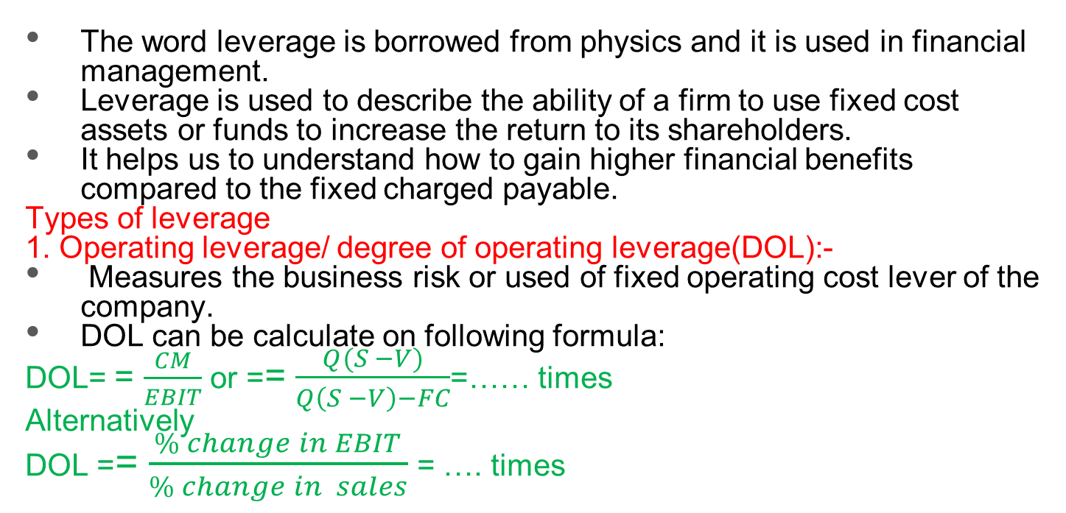
Leverage
The word leverage is borrowed from physics and it is used in financial management.
Leverage is used to describe the ability of a firm to use fixed cost assets or funds to increase the return to its shareholders.
It helps us to understand how to gain higher financial benefits compared to the fixed charged payable.
Types of leverage
1. Operating leverage/ degree of operating leverage(DOL):-
Measures the business risk or used of fixed operating cost lever of the company.
DOL can be calculate on following formula:
DOL= = $\frac{CM}{EBIT}$ or == $\frac{Q(S −V)}{Q\left(S −V\right)−FC}$=…… times
Alternatively
DOL == $\frac{\% change in EBIT}{\% change in sales}$ = …. times

Slide 9
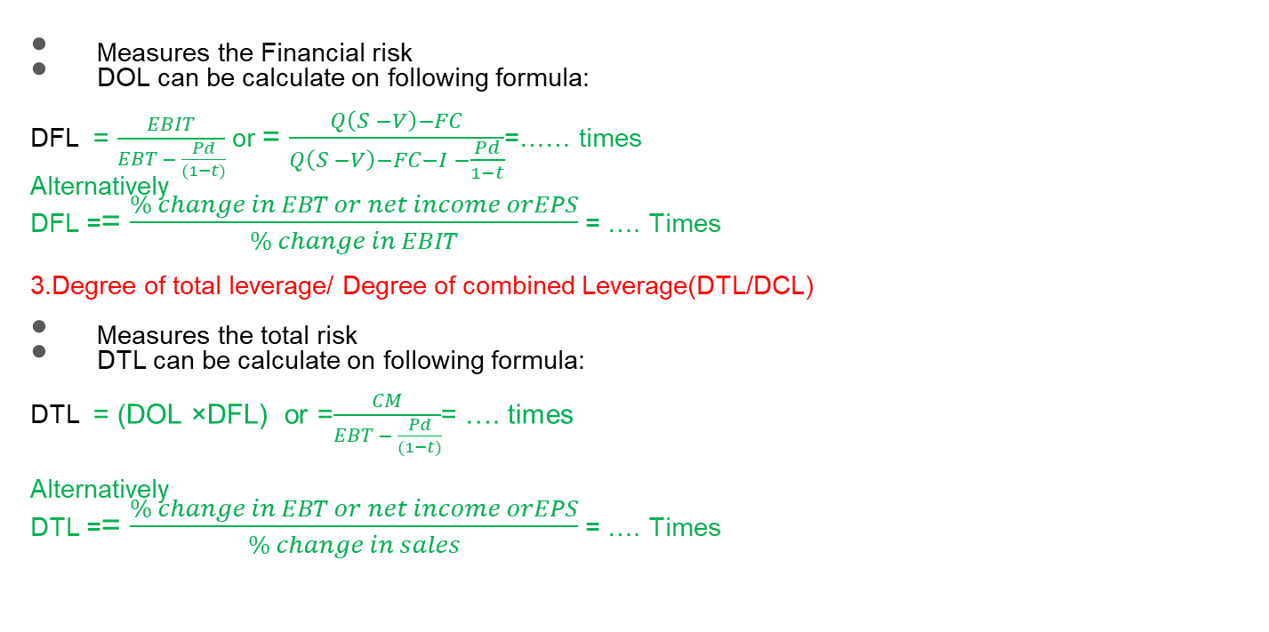
2. Degree of Financial Leverage(DFL)
Measures the Financial risk
DOL can be calculate on following formula:
DFL = $\frac{EBIT}{EBT − \frac{Pd}{(1−t)}}$ or = $\frac{Q\left(S −V\right)−FC}{Q\left(S −V\right)−FC−I −\frac{Pd}{1−t}}$=…… times
Alternatively
DFL == $\frac{\% change in EBT or net income orEPS}{\% change in EBIT}$ = …. Times
3.Degree of total leverage/ Degree of combined Leverage(DTL/DCL)
Measures the total risk
DTL can be calculate on following formula:
DTL = (DOL ×DFL) or =$\frac{CM}{EBT − \frac{Pd}{(1−t)}}$= …. times
Alternatively
DTL == $\frac{\% change in EBT or net income orEPS}{\% change in sales}$ = …. Times

Slide 10

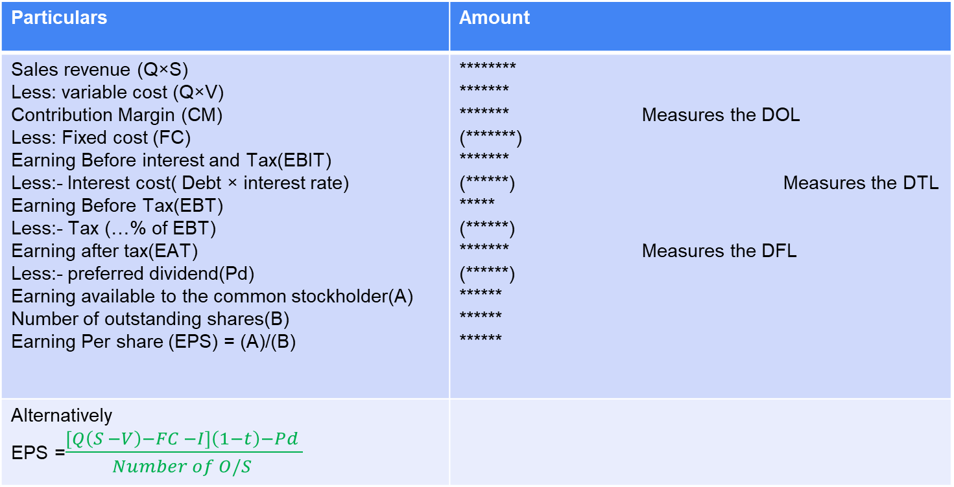
Prepare income statement
Particulars | Amount
Sales revenue (Q×S) Less: variable cost (Q×V) Contribution Margin (CM) Less: Fixed cost (FC) Earning Before interest and Tax(EBIT) Less:- Interest cost( Debt × interest rate) Earning Before Tax(EBT) Less:- Tax (…% of EBT) Earning after tax(EAT) Less:- preferred dividend(Pd) Earning available to the common stockholder(A) Number of outstanding shares(B) Earning Per share (EPS) = (A)/(B) | ******** ******* ******* Measures the DOL (*******) ******* (******) Measures the DTL ***** (******) ******* Measures the DFL (******) ****** ****** ******
Alternatively EPS =$\frac{\left[Q\left(S −V\right)−FC −I\right]\left(1−t\right)−Pd }{Number of O/S }$

Slide 11
Where,
Q= number of production and sells units
S= selling price per unit
V= variable cost per unit
FC =Fixed cost / Fixed operating cost
I = interest cost ie(Interest rate × Debt amount)
Pd = Preferred Dividend
T = tax rate
DOL = Degree of operating Leverage
DFL = Degree of Financial Leverage
DTL/DCL = Degree of Total leverage or Degree of Combined leverage
Total Fixed Cost = cash FC + Depreciation
Cash FC = Total FC – Dep.

Slide 12
The End

